Slide 1
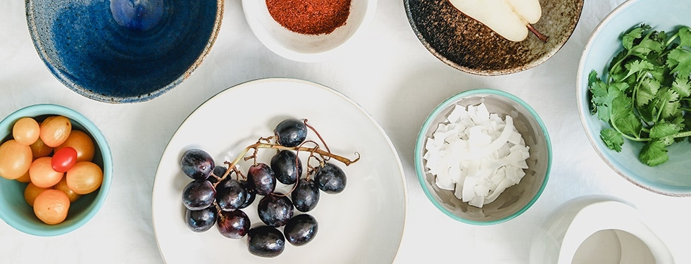
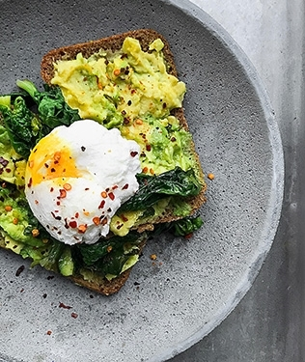
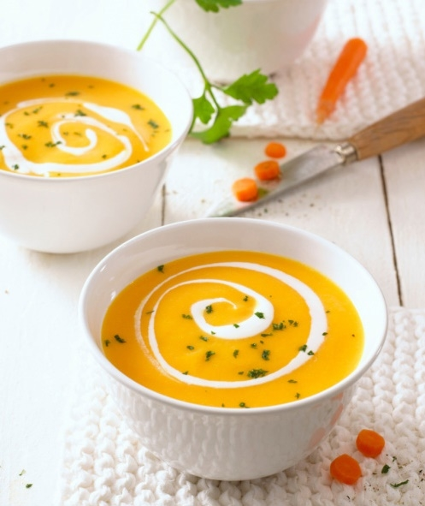
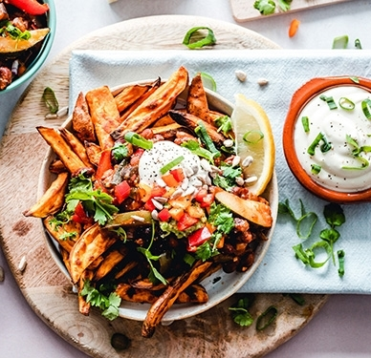
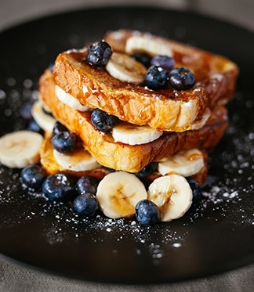
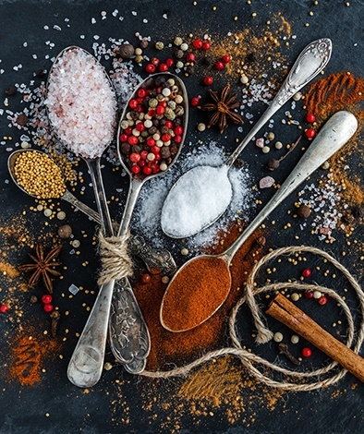
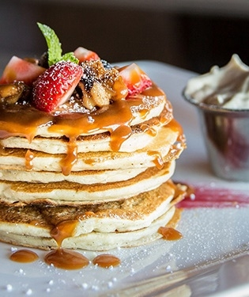
Recipe Food App

Slide 2
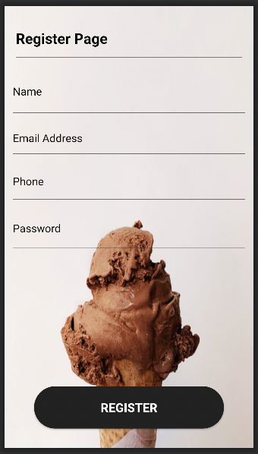
Register Screen
Screen contain four rows:
- user name field
- Email-Address field - Phone field
- Password field

Slide 3
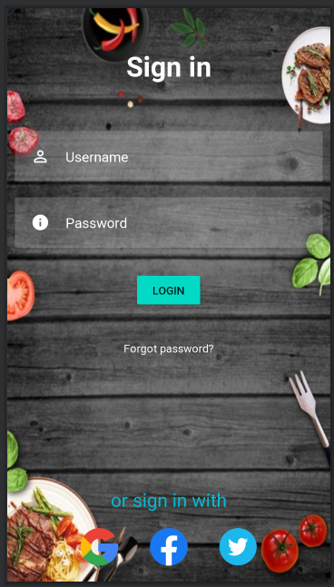
Login Screen
Screen contain two rows:
- Email-Address field - Password field

Slide 4
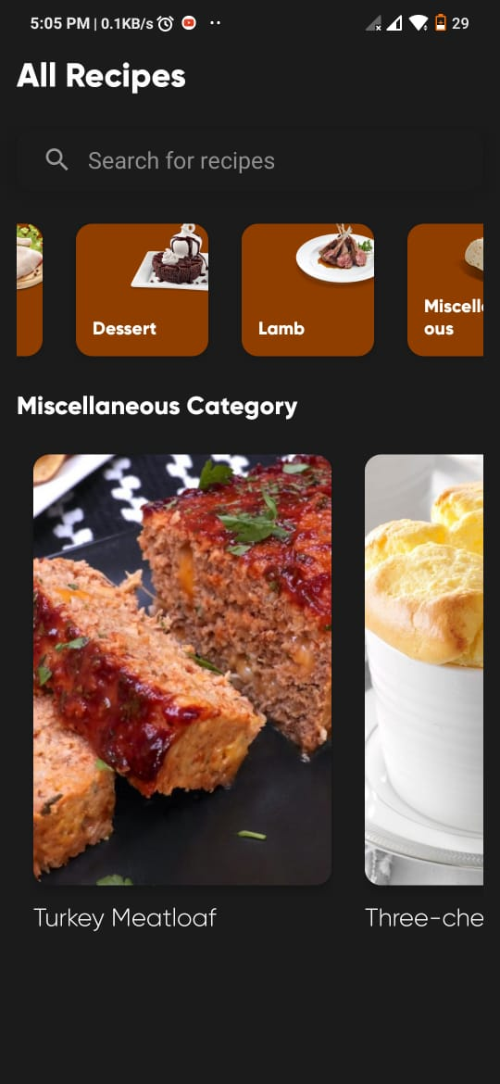
Home Screen
Home Screen contain 3 fields:
- Search box
- list of main categories
- list of category

Slide 5
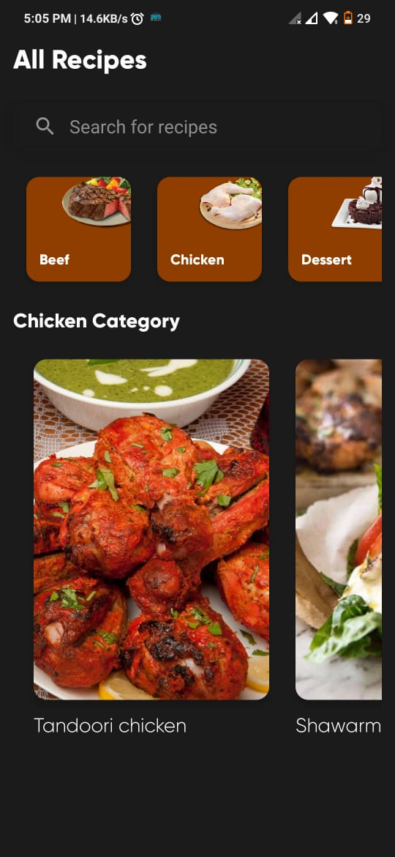
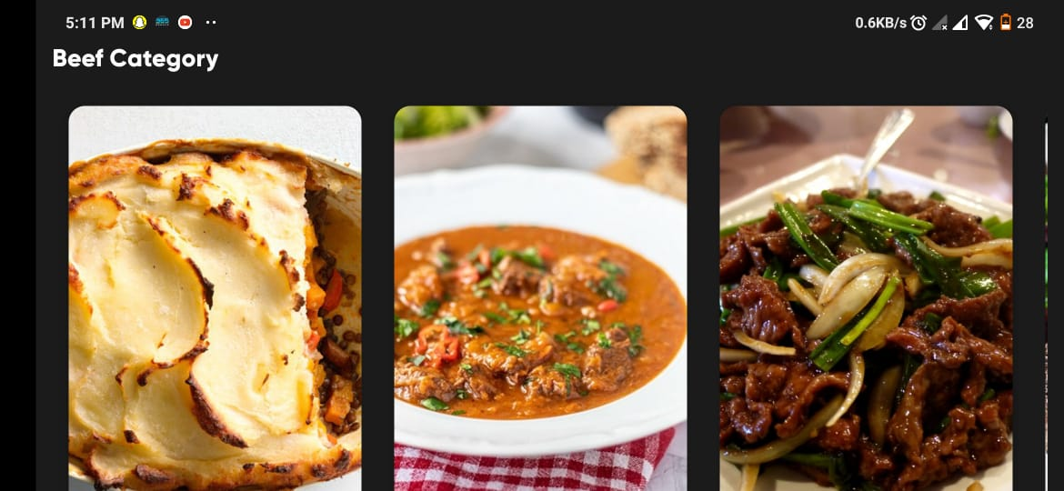
Beef
Ingredients
Vegetable shepherd’s pie
4 russet potatoes.
3 carrots.
3 stalks celery.
½ yellow onion.
2 cups chopped mushrooms.
1 tablespoon flour.
1 teaspoon fresh thyme.
1 teaspoon fresh sage list of Ingredients
Vegetable shepherd’s pie
Traditional Soup
Szechuan Beef

Slide 6
Beef
Ingredients
Traditional Soup
3 cups fresh broccoli florets
2 cups diced peeled potatoes
2 cups water
1/3 cup sliced green onions
1 teaspoon salt
1/2 teaspoon pepper
3 tablespoons butter
3 tablespoons all-purpose flour
1/8 teaspoon ground nutmeg
2 cups whole milk
1/2 cup shredded cheddar cheese
Vegetable shepherd’s pie
Traditional Soup
Szechuan Beef

Slide 7
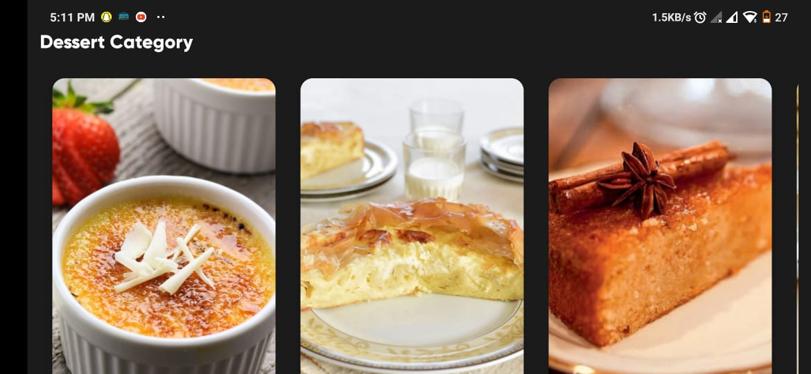
Dessert
Ingredients
White Chocolate crème
100g Green & Black's white chocolate , broken into pieces.
1 vanilla pod, split or 1 tsp vanilla extract.
6 egg yolks.
2 tbsp golden caster sugar , plus extra for topping.
White Chocolate crème
Walnut Roll Guzvara
Tunisian Orange Cake

Slide 8
Dessert
Ingredients
Tunisian Orange Cake
50 grams gluten free bread crumbs or polenta.
200 grams golden caster sugar.
100 grams ground almonds.
1.5 tsp baking powder.
200 ml sunflower oil.
4 large free-range eggs.
1 lemon zested.
1 orange zested.
White Chocolate crème
Walnut Roll
Tunisian Orange Cake

Slide 9
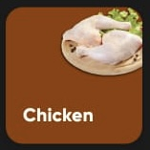
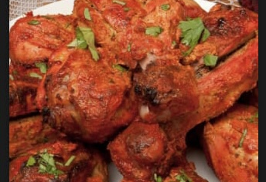
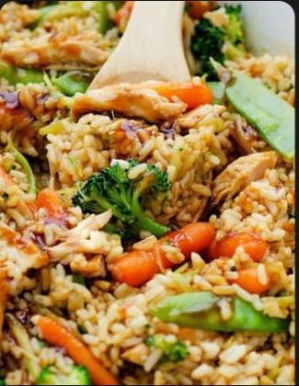
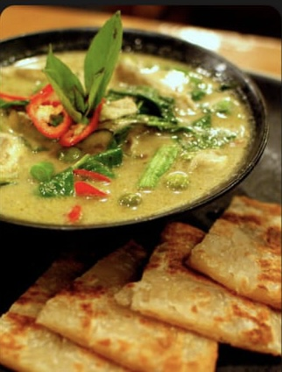
Chicken
Ingredients
Tandoori Chicken
½ kg chicken (500 to 700 grams)
½ cup greek yogurt ¾ tbsp ginger garlic paste.
1 tsp red chilli powder ¼ tsp black pepper crushed (powder)
1 tsp coriander powder (daniya powder)
¼ tsp salt (taste marinade & add more)
¼ tsp Turmeric (haldi)
Tandoori Chicken
Teriyaki Chicken Casserole
Thai Green Curry
Add nutritional information

Slide 10
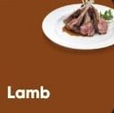
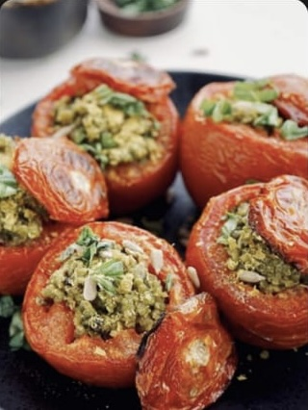
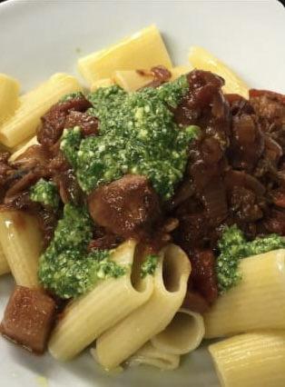
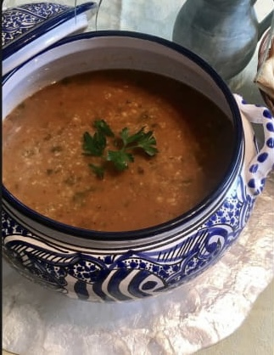
Lamb
Ingredients
Stuffed Lamb Tomatoes
4 large, ripe vine tomatoes.
2 tsp extra virgin olive oil, plus extra for drizzling.
200g/7oz lamb mince.
1 tsp onion powder.
1 tsp garlic powder.
½ tsp dried oregano.
1 tbsp tomato purée.
30g/1oz Parmesan, finely grated.
Stuffed Lamb Tomatoes
Rigatoni With Fennel
Tunisian Lamb Soup
Add nutritional information

Slide 11
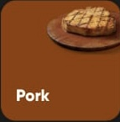
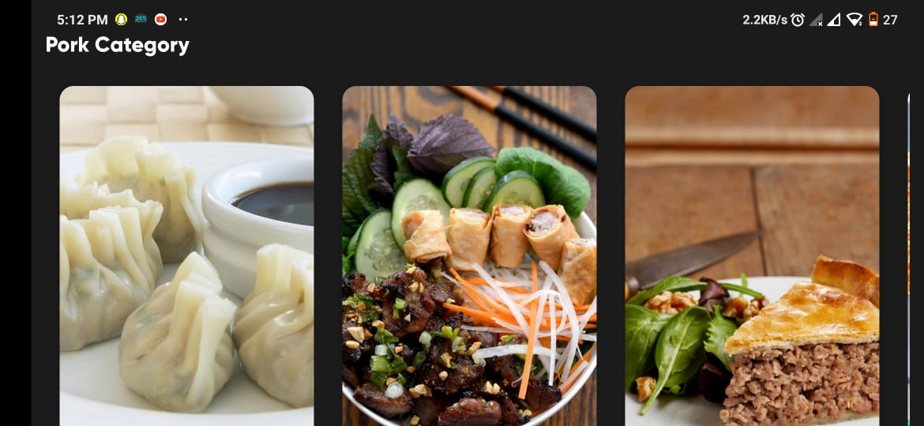
Pork
Ingredients
Wontons
1/2 lb. ( 0.2 kg) ground pork, chicken or turkey.
1/4 lb. ( 0.1 kg) shrimp, chopped into small pieces.
1/2 teaspoon soy sauce or fish sauce.
1/2 teaspoon sesame oil.
3 dashes ground white pepper.
1 pack store-bought wonton wrappers.
water, for sealing.
Wontons
Vietnamese Grilled Pork
Touriere
Add nutritional information

Slide 12
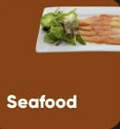
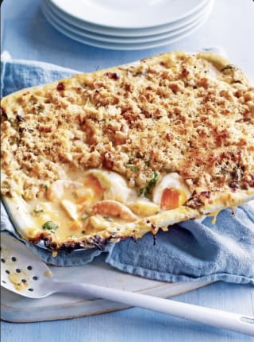
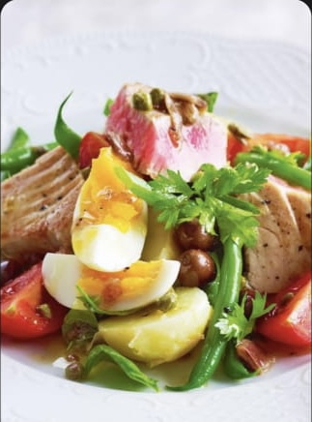
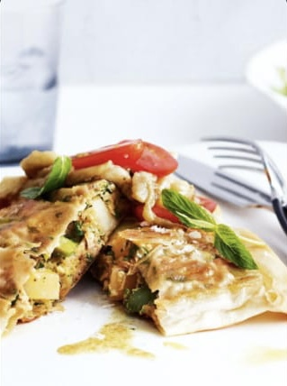
Seafood
Ingredients
Three Fresh Pie
1 cup fresh strawberries, halved.
2 cups fresh raspberries.
1 ½ cups fresh blueberries.
½ cup white sugar.
3 tablespoons cornstarch
Three Fresh Pie
Tuna Nicoise
Tuna and Eggs Briks

Slide 13
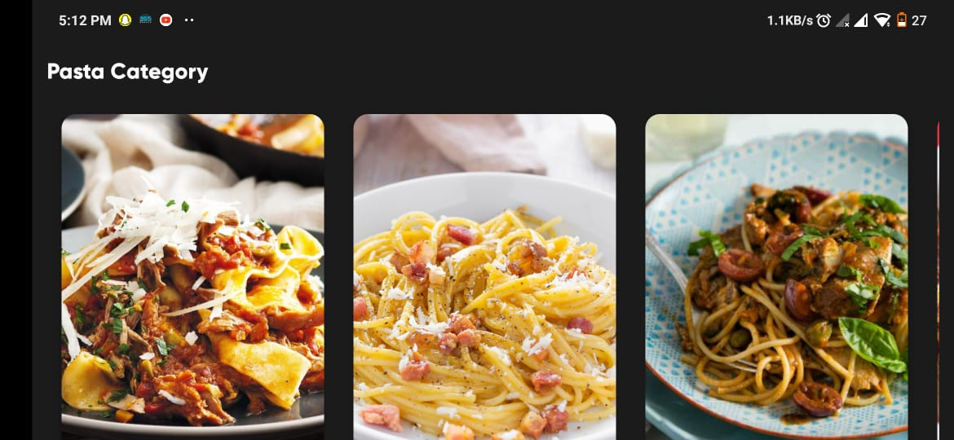
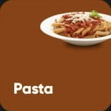
Pasta
Ingredients
Spaghetti Alla Carbonara
100g pancetta.
50g pecorino cheese.
50g parmesan.
3 large eggs.
350g spaghetti.
2 plump garlic cloves, peeled and left whole.
50g unsalted butter.
sea salt and freshly ground black pepper.
Spaghetti Alla Carbonara
Pasta White Sauce
Pilchard Puttanesca

Slide 14
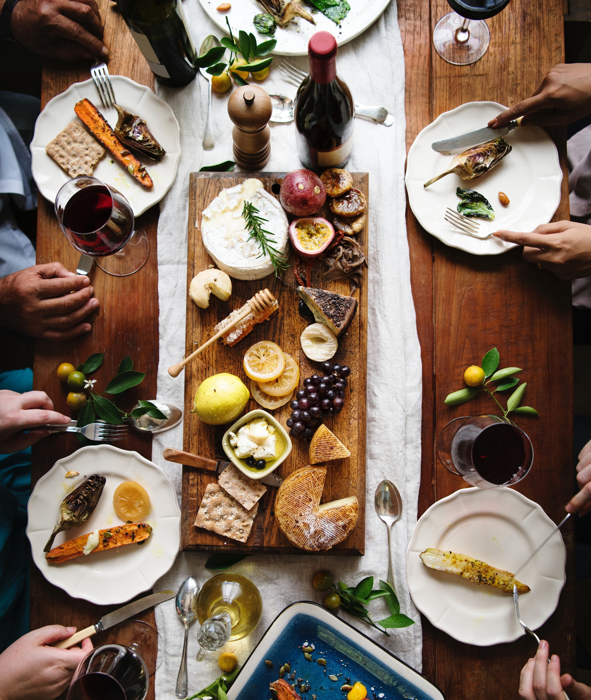
Contributors
Waleed Elsayed Essawy
Omar Reda Mohamed
Mohamed Mossad Farouk
Ahmed Mohamed Fawzy
Ali Taha Nasr

